Slide 1
Machine Learning with Membership Privacy using Adversarial Regularization
MI L AD N AS R , R E Z A S H OKR I , A MI R H O UMANSADR C C S 2 0 1 8

Slide 2
Summary
Problem: machine learning models leak information about the dataset on which they are trained
Goal: build a model that maximize privacy and prediction accuracy
Contributions:
Introduce a privacy mechanism that solves the min-max privacy game
Privacy mechanism also regularizes the models
Evaluation:
Tested on 3 datasets and resulting models achieved maximum privacy while minimizing classification loss
Cost of achieving membership privacy is negligible in terms of classification error

Slide 3
Content of the paper
Membership privacy with machine learning
Can’t trace individual members that are part of a model’s training set
Introducing their privacy mechanism to train machine learning models
Modeling the optimization problem as min-max game
Minimizing the classification loss and the maximum gain of the inference attack
Evaluate their privacy mechanism on deep neural networks using different datasets

Slide 4
Meaning of the paper
By solving min-max optimization problem, we can achieve membership privacy
The attacker can’t design a better inference attack than what is already anticipated by the defenser
Solved the problem by training the model in an adversarial process

Slide 5



Background: classification model
Training classification models using supervised learning
Classification model f
Dog
Cat
X
𝑓: 𝑋 → 𝑌
Y

Slide 6




Background: classification model
Classification model f
Cat
This distribution is unknown to
the learning algorithm

Slide 7

Background: classification model
Averaging the loss function on the training set D
Minimize the expected empirical loss of the model over its training set D

Slide 8



Classification model: optimization problem
Minimizing the loss function
Avoid overfitting with regularization

Slide 9
Classification model: optimization problem
Minimizing by using stochastic gradient descent
Each epoch selects a small subset of training set D
Update the parameters towards reducing the loss function
After several epochs, algorithm will converge to the local minimum of the loss function

Slide 10
Classification model: optimization problem
Regularization
Make things regular or acceptable
Reduce error by fitting a function appropriately on given training set and avoid overfitting
Tuning parameter 𝜆: should be carefully selected
After certain value, can cause underfitting

Slide 11
Background: inference model
Membership inference attack: determine membership of data record in the training set
MIA in machine learning is not simple in black-box setting
Distinguishing training set members from non-members by observing the predictions
Predictions are non-linear computations on the training set
Create an inference model
Find the difference between the predictions on members and on non-members

Slide 12
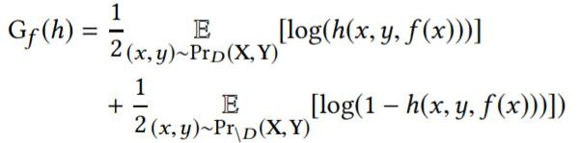



Background: inference model
ℎ: 𝑋 × 𝑌2 → 0,1
Input: 𝑥, 𝑦 and the model’s prediction vector 𝑓(𝑥)
Output: probability of (𝑥, 𝑦) being a member of D
Correctness of the inference
model when data is sampled
from the training set
Correctness of the inference
model when data is sampled
outside the training set
Pr_{D}(X,Y) and Pr_{\D}(X,Y) are not accurately available to the attacker

Slide 13
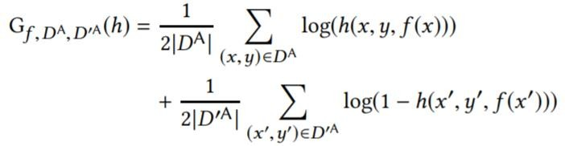

Inference model: optimization problem
D ^{A} : dataset sampled from the training set and could be known to the adversary
D’ ^{A} : dataset sampled outside the training set which are known to be non-members
One simple goal!

Slide 14
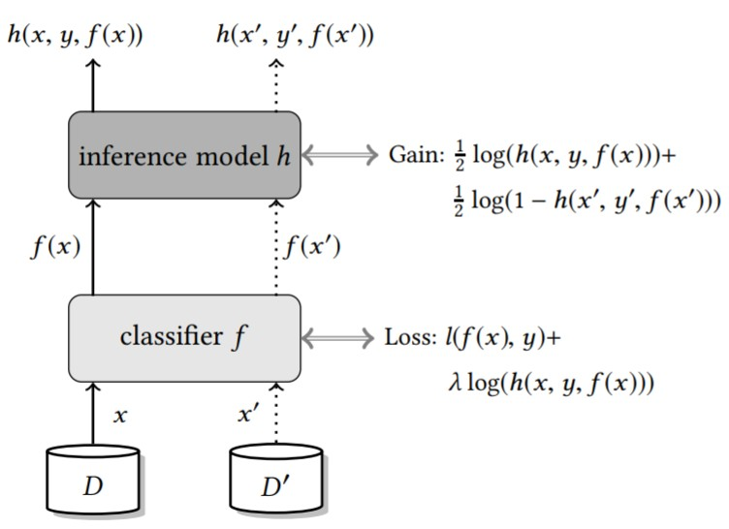


Adversarial training
Mini-batch size is set to 1 for simplification
Classification loss is computed over D
Inference model is computed on both sets
Reference set
Training set

Slide 15
Min-max membership privacy game
Adversary is one step ahead
Adapts his inference attack to maximize his gain for a specific model
Defense mechanism is broken
Designed for a particular attack
Not anticipating and preparing for the strongest attack against itself
Different objectives
Adversary: maximum inference gain
Defender: minimum loss and minimizing adversary’s maximum gain
Min-max game

Slide 16
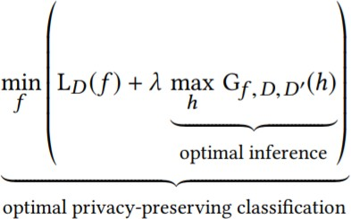
Min-max membership privacy game
Training objective: minimizing privacy loss w.r.t the strongest inference attack
𝜆 is the regularizer: prevents the classification model from leaking information

Slide 17
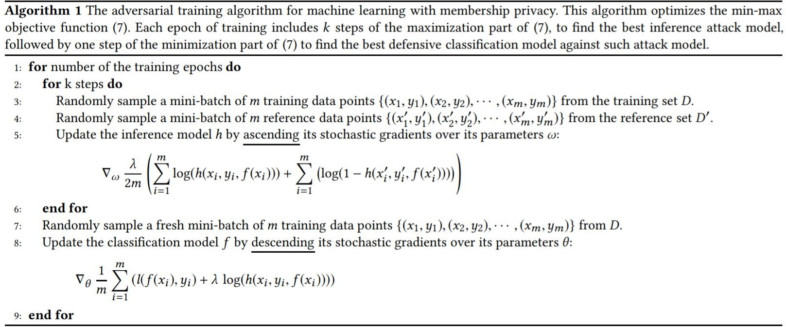
Adversarial training algorithm
Maximizing the the empirical
inference gain with
stochastic gradient ascent
Minimize the empirical classification loss
with stochastic gradient descent

Slide 18

Theoretical analysis
Ultimate goal: training a classification model that has indistinguishably similar output distributions for data members of training set versus the non-members
Achieving maximum value of 𝐺_{𝑓}(ℎ) where ℎ∗ is the optimal attack model:
𝑝_{𝑓} is the probability distribution of 𝑓 of its output on its training data D
𝑝′_{𝑓} is the probability distribution of 𝑓 on any data points outside the training dataset

Slide 19

Theoretical analysis
Ultimate goal: training a classification model that has indistinguishably similar output distributions for data members of training set versus the non-members
Achieving maximum value of 𝐺_{𝑓}(ℎ) where ℎ∗ is the optimal attack model:
Determine membership by comparing probability
that the prediction 𝑓(𝑥) comes from 𝑝_{𝑓} or 𝑝′_{𝑓}

Slide 20

Theoretical analysis
Solving this equation to obtain a privacy-preserving classification task
The optimal function 𝑓∗ is global minimization function if: 𝑝_{𝑓∗} = 𝑝′_{𝑓∗}
Two distributions 𝑝_{𝑓∗} and 𝑝′_{𝑓∗} are indistinguishable

Slide 21
Experiments: datasets
CIFAR100
Benchmark dataset for image recognition algorithms
60,000 images
Purchase100
Shopping records for thousands of people
197,324 records
Texas100
Hospital discharge data
67,330 records
Datasets used in the original membership inference attack against ML models

Slide 22
Classification models: CIFAR100
AlexNet architecture
Adam optimizer: extension to stochastic gradient descent
0.0001 learning rate
100 epochs
DropOut regularizer: drops randomly selected neurons during training
DenseNet architecture
Classical stochastic gradient descent
0.001 / 0.0001 / 0.00001 learning rates depending on the number of epochs
300 epochs
L2-norm regularization

Slide 23
Classification model: Purchase100
4-layer fully connected neural network
Layer sizes [1024,512,256,100]
Tanh activation functions
All parameters initialized with random normal distribution
50 epochs of training

Slide 24
Classification models: Texas100
5-layer fully connected neural network
Layer sizes [2048,1024,512,256,100]
Tanh activation functions
All parameters initialized with random normal distribution
50 epochs of training

Slide 25

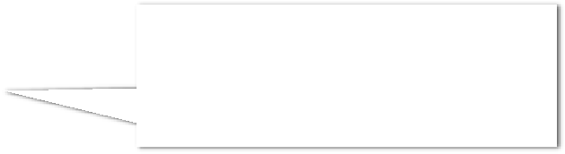
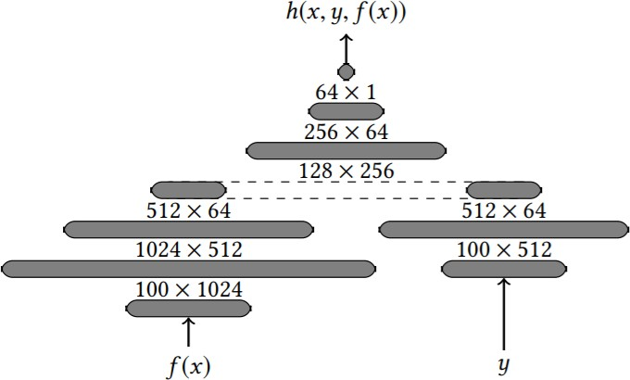



Inference attack model
Membership
probability of
a target record
Concatenation of the output of
the 2 other neural networks
Operates on the prediction vector of the classification model
Operates on
the label

Slide 26
Inference attack model
ReLuactivation function
Adam optimizer
0.001 learning rate
Every training batch has same number of member and non-member
Avoid bias toward one side

Slide 27
Training data
Dataset | |D| | |D’| | 𝝀 | |D^{A}| | |D’ ^{A}|
Purchase100 | 20,000 | 20,000 | 3 | 5,000 | 20,000
Texas100 | 10,000 | 5,000 | 2 | 5,000 | 10,000
CIFAR100 | 50,000 | 5,000 | 6 | 25,000 | 5,000
D: Training set
D’: Reference set
λ: Regularization factor
D^{A}: Adversary’s known members of training set
D’ ^{A}: Adversary’s known non-members

Slide 28
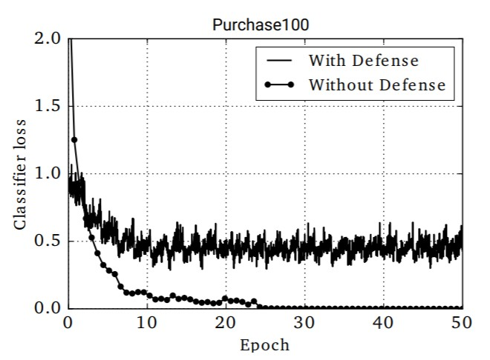
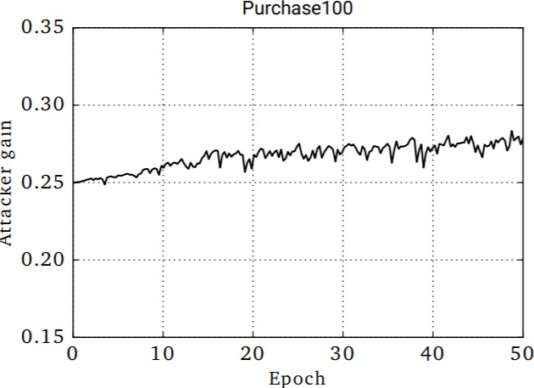
Loss and gain
Throughout the training with Algorithm 1
Attacker’s gain is the maximum that can be achieved against the best defense
Defenser’s classifier prevents the attacker’s gain to grow

Slide 29
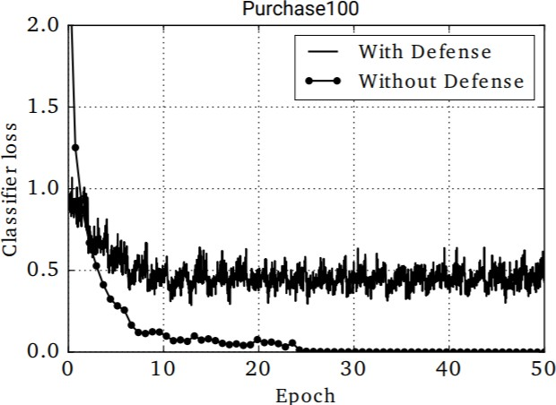
Loss and gain

Slide 30
Effect of adversarial regularization
Tradeoff between privacy and predictive power of privacy-preserving models?
Cumulative distribution of the model’s generalization error over different classes
For each class, model’s generalization error = training accuracy – testing accuracy for samples for that class

Slide 31
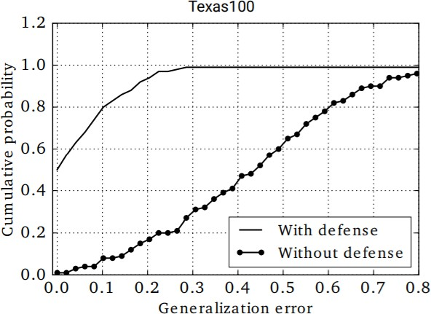
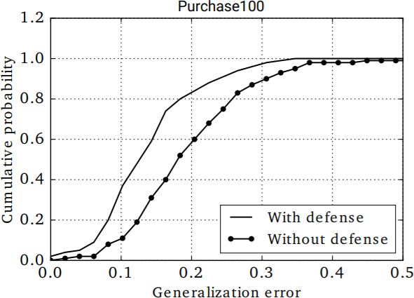
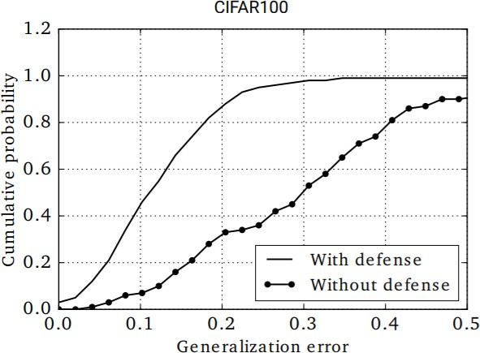

Effect of adversarial regularization
Generalization error of the privacy mechanism is
significantly lower over all the classes

Slide 32
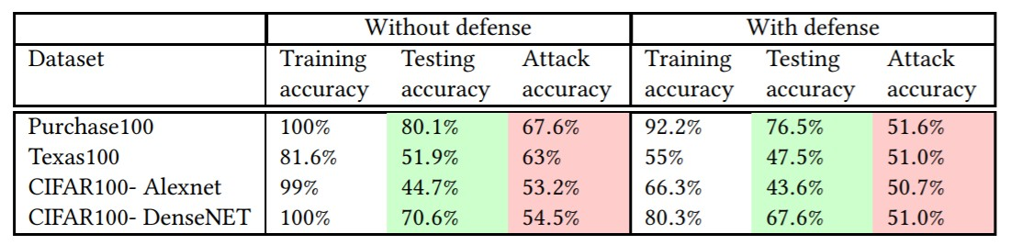
Effect of adversarial regularization
Generalization error:
19.9%
Generalization error:
15.7%

Slide 33
Effect of adversarial regularization
Generalization error:
29.7%
Generalization error:
7.5%

Slide 34
Effect of adversarial regularization
Generalization error:
54.3%
Generalization error:
22.7%

Slide 35
Effect of adversarial regularization
Generalization error:
29.4%
Generalization error:
12.7%

Slide 36
Effect of adversarial regularization
Noticeable gap training and testing accuracy with or without defense between mechanism
Total generalization error is reduced up to a factor of 4 (Texas100)
29.7% down to 7.5%
min-max mechanism achieves membership privacy with the minimum generalization error

Slide 37
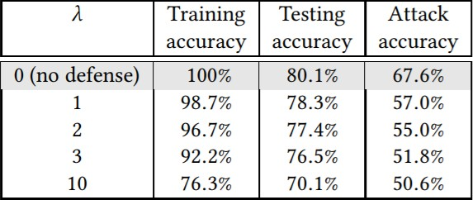
Regularization factor for Purchase100

Slide 38
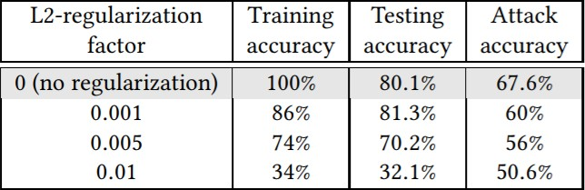

Tradeoff between test accuracy and membership privacy using L2-norm
Training and testing accuracy suffer a lot to achieve privacy
Privacy mechanism achieved 70.1% testing accuracy for maximum degree
of membership

Slide 39
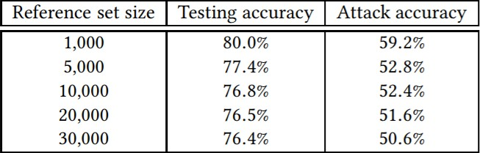

Effect of the reference set D’ for Purchase100
All trained with the same training set D of size 20,000 and 𝝀 = 3
As the reference set size increases, attack accuracy decreases

Slide 40
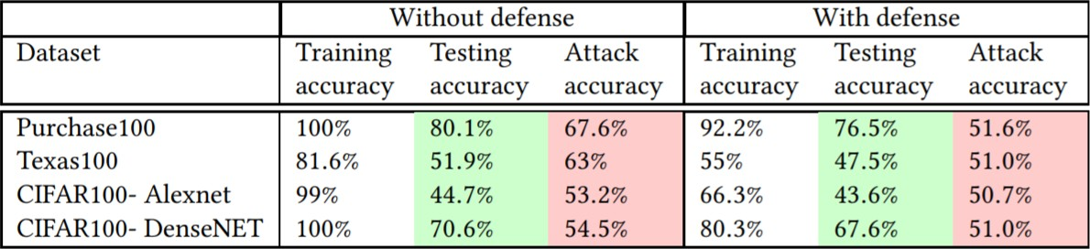



Privacy and attack accuracy
Close to random guess with
privacy mechanism
Average probability that the inference attack model predicts the membership

Slide 41
Privacy and attack accuracy
Maximum achievable membership
privacy with only a negligible drop
in the model’s predictive power
Almost no difference in predictive power

Slide 42

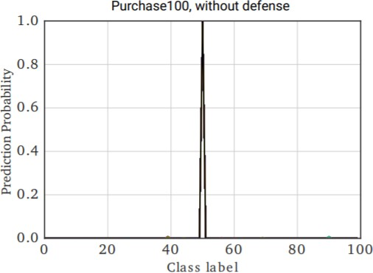

Indistinguishability of predictions
All inputs are from class 50 from Purchase100
Model is overfitted
Vulnerability to membership inference attack because produce high probability for the correct class on its training data
High probability on its
training data (Class 50)

Slide 43
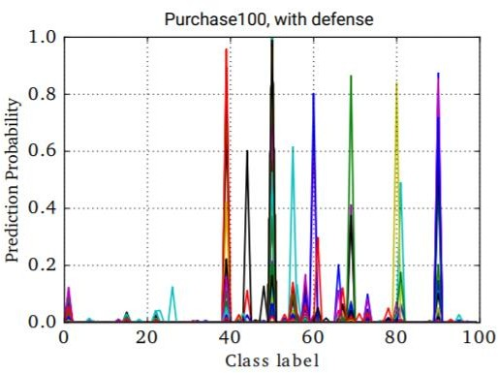
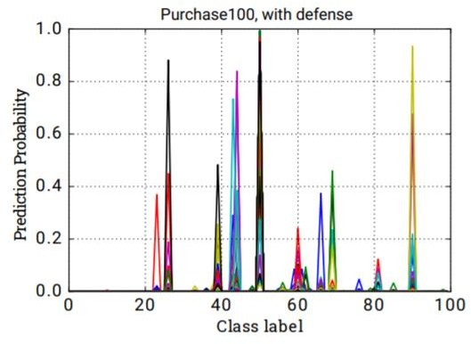

Indistinguishability of predictions
Prediction is spread across multiple classes

Slide 44
Indistinguishability of predictions
Test data samples (right) is
indistinguishable training data (left)

Slide 45
Prediction accuracy and uncertainty
Investigate indistinguishability further with different datasets
Computed accuracy and uncertainty
Accuracy: probability of predicting the right class for a given sample
Uncertainty: normalized entropy of the model’s prediction vector
Plotting both models, with and without defense
2 curves: members and non-members
Larger gap between the curves indicates information leakage about the training set
Question: what do the plots represent exactly?

Slide 46
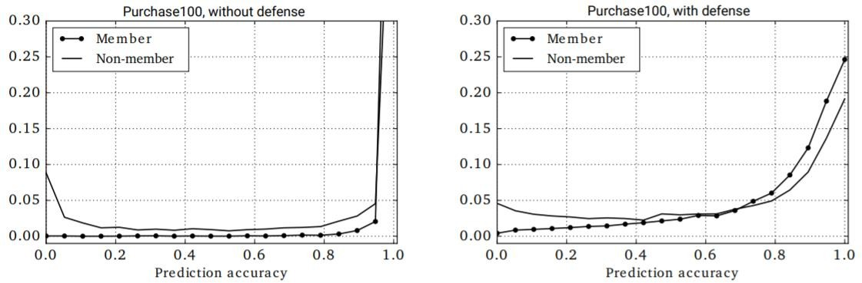

Prediction accuracy: Purchase100
Maximum gap: 0.34 vs 0.02
Average gap: 0.013 vs 0.007

Slide 47
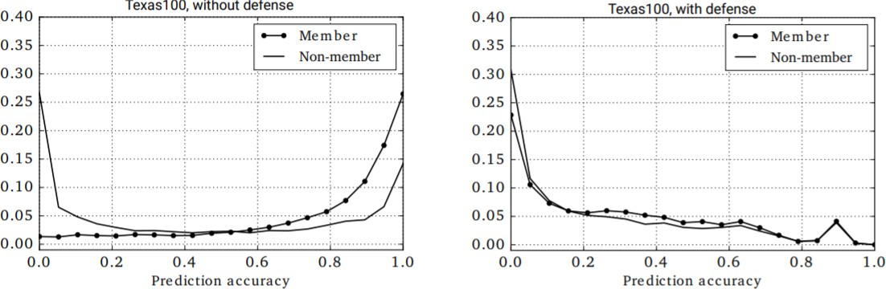
Prediction accuracy: Texas100
Maximum gap: 0.25 vs 0.05
Average gap: 0.016 vs 0.004

Slide 48
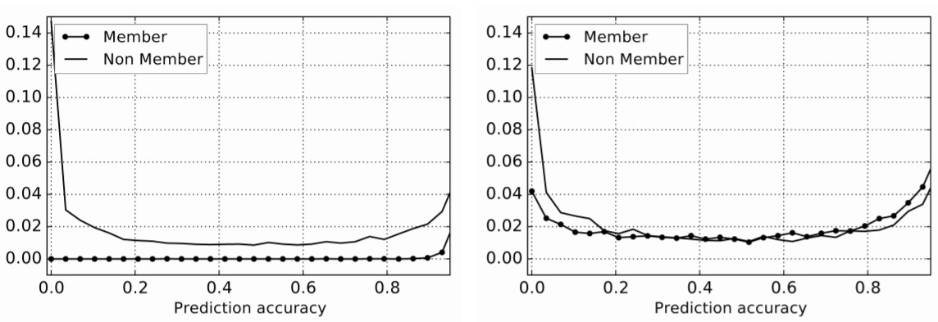
Prediction accuracy: CIFAR100-DN
Maximum gap: 0.56 vs 0.06
Average gap: 0.021 vs 0.005

Slide 49
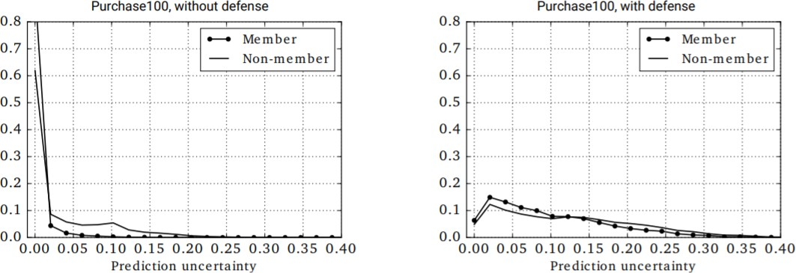
Prediction uncertainty: Purchase100
Maximum gap: 0.30 vs 0.03
Average gap: 0.012 vs 0.004

Slide 50
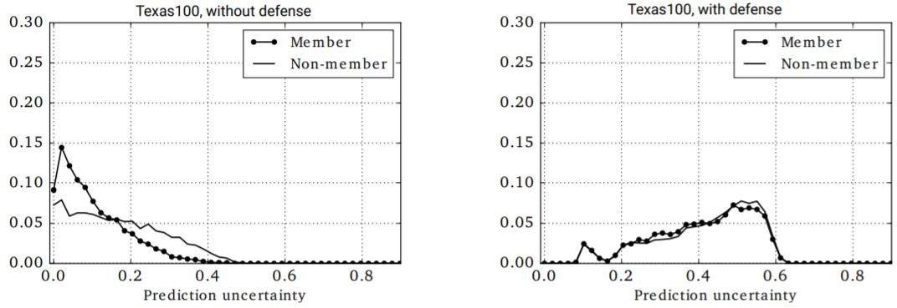
Prediction uncertainty: Texas100
Maximum gap: 0.15 vs 0.02
Average gap: 0.04 vs 0.002

Slide 51
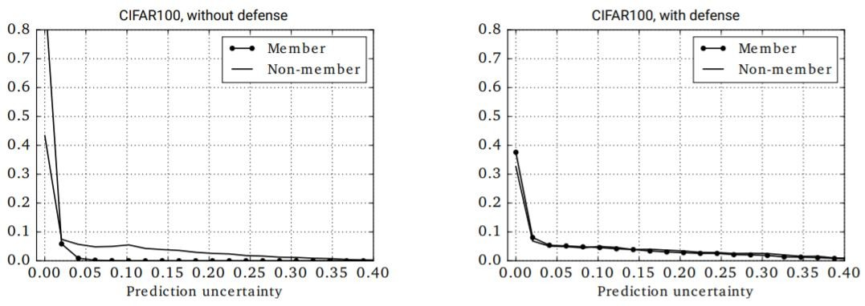
Prediction uncertainty: CIFAR100-DN
Maximum gap: 0.49 vs 0.04
Average gap: 0.01 vs 0.002

Slide 52

Indistinguishability of predictions
Privacy mechanism reduces the maximum and average gap between the curves
Prediction accuracy and uncertainty of the model is reduced on training vs test set
CIFAR100-Alexnet not mentionned

Slide 53
Conclusion
New privacy mechanism for mitigating membership inference attacks
Optimization problem: maximize privacy and prediction accuracy
Algorithm that solves a min-max game optimization
Solution: model whose predictions on its training data are indistinguishable from its predictions on any data from the same distribution
Maximum privacy against strongest inference attack
Minimum accuracy loss

Slide 54
Questions

